Slide 1
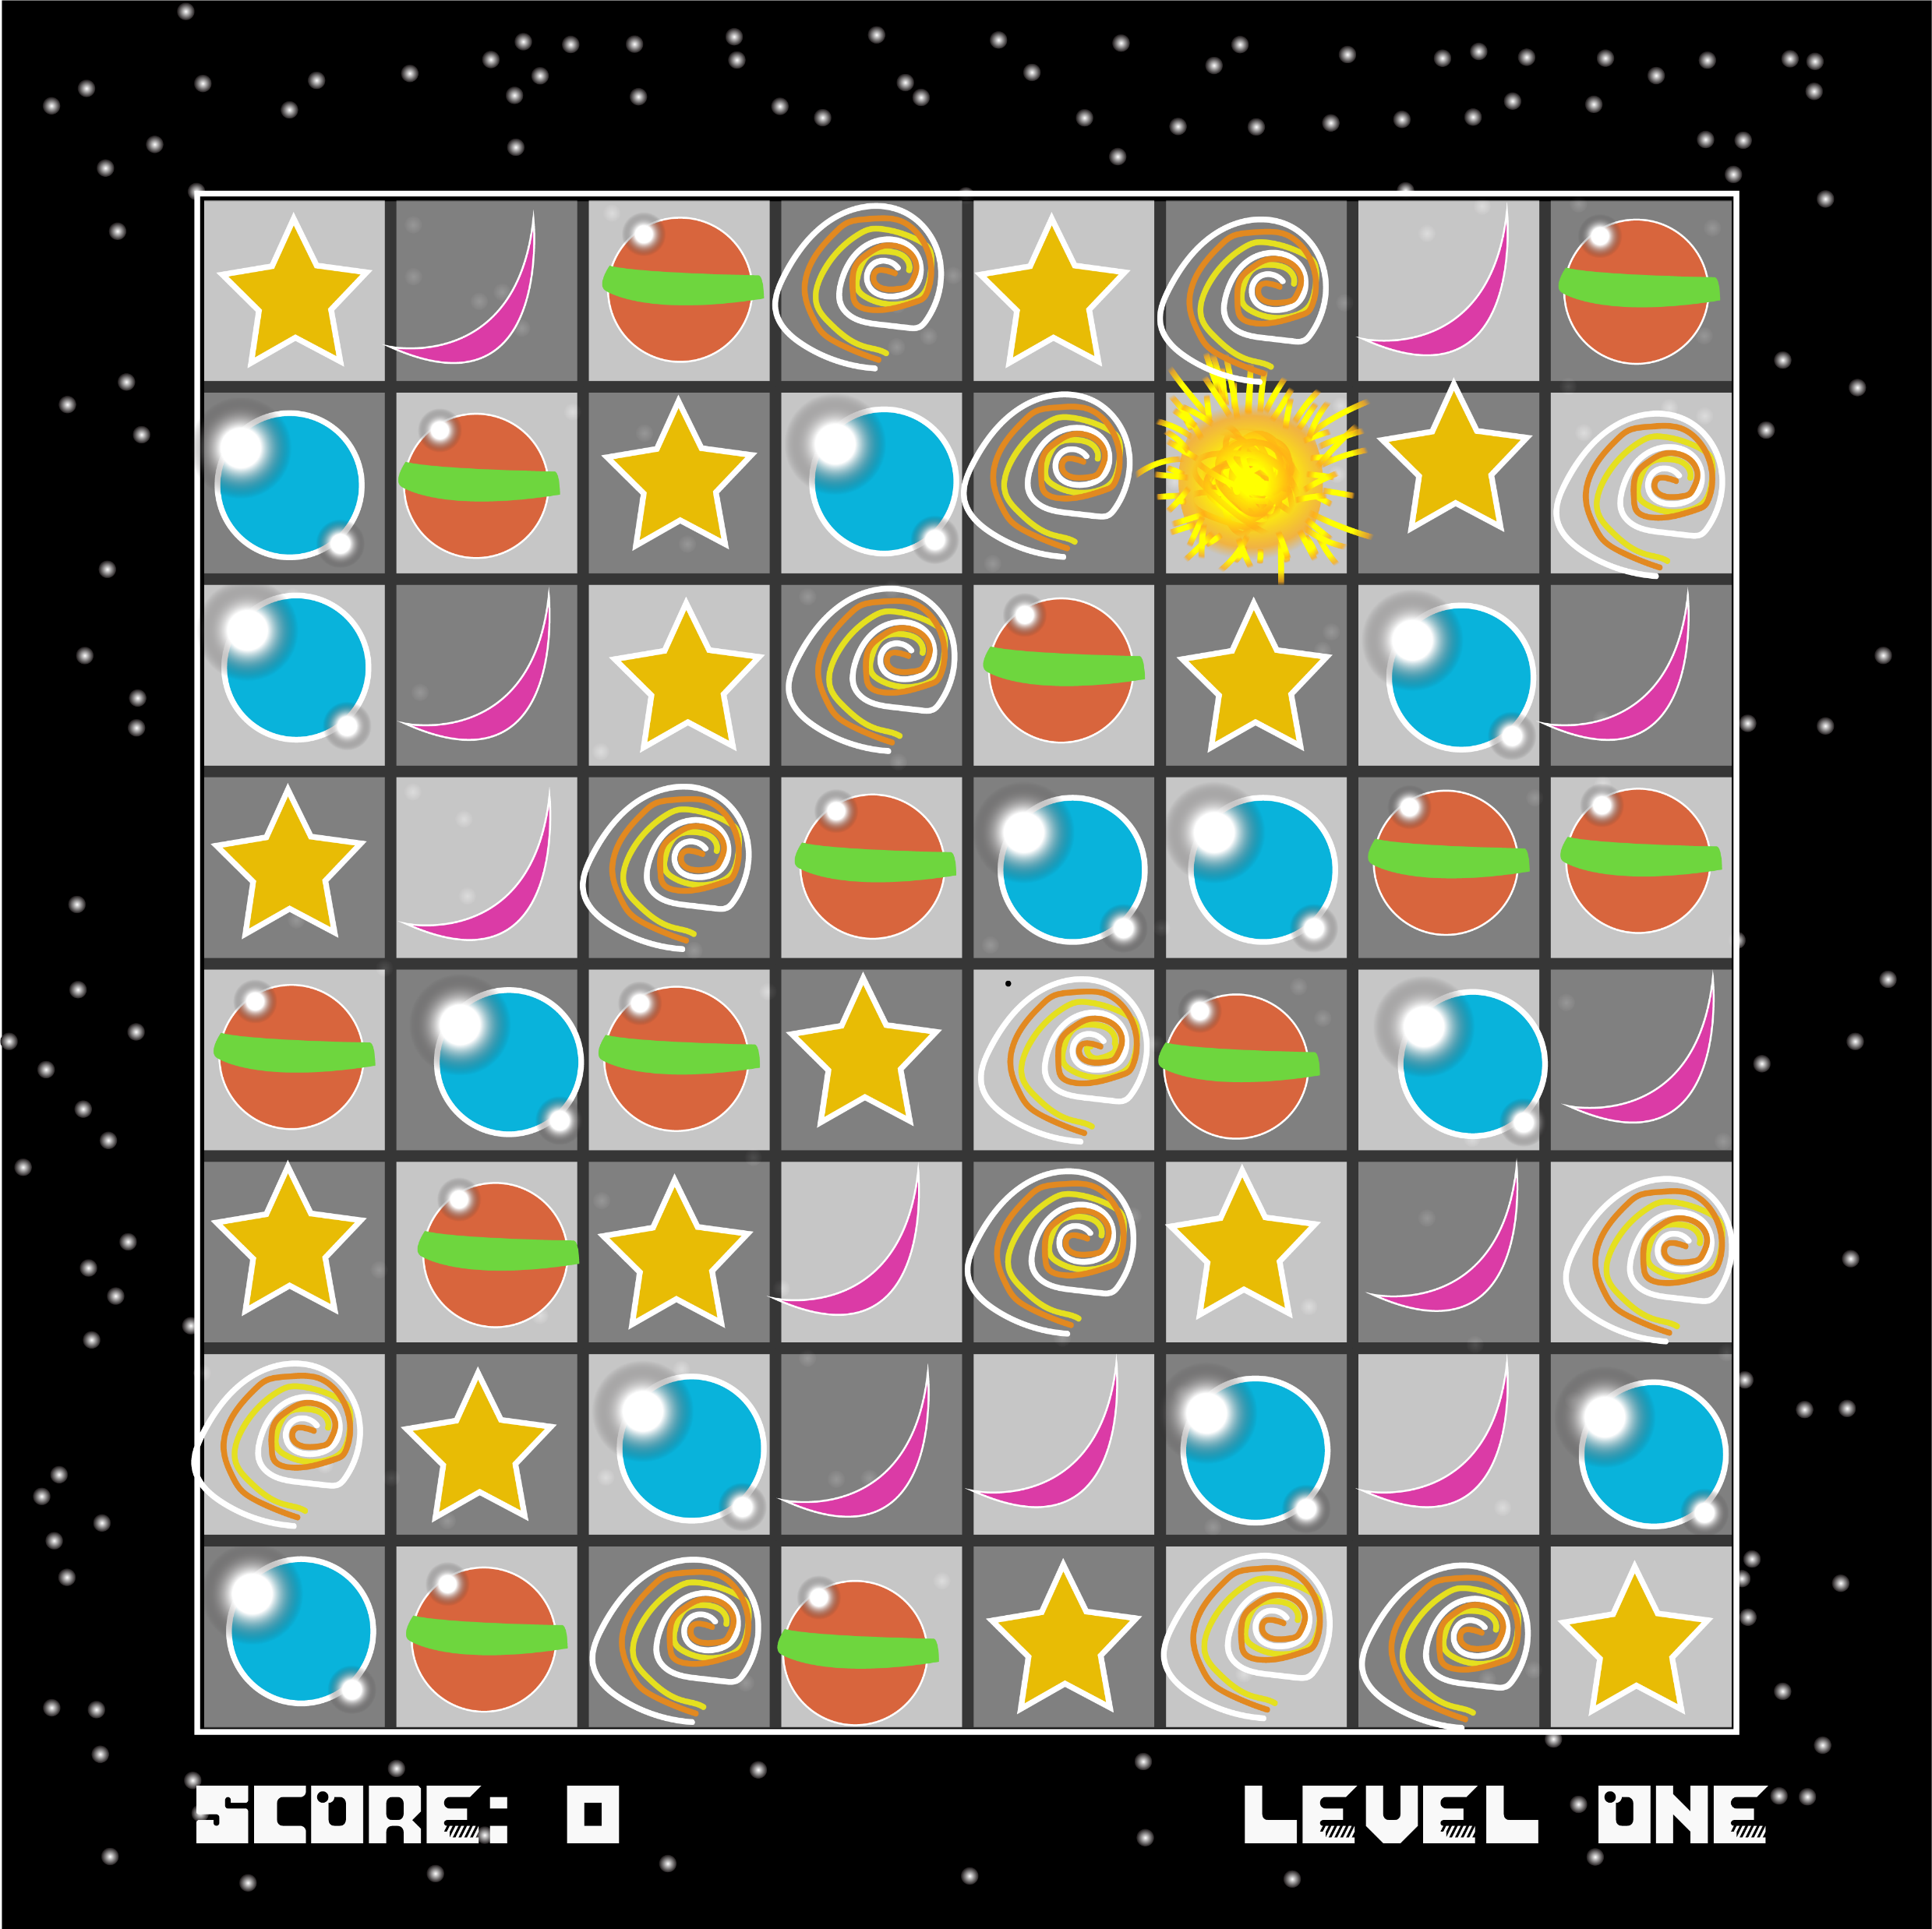
Astro Match
A Match-Three Game

Slide 2
What is it again?
5 types of pieces fall to grid
Player must match 3 pieces of the same type
Special pieces when >3 is matched
Basically Bejeweled

Slide 3
Features & Requirements
Multiple levels, become larger as game progresses
Multiple pieces – Object Pool
Local scoreboard tracking, score system - Singleton
Can Undo moves (limited, decreases score) - Command
Gameplay affects UI (Screen Shakes, etc.) - Observer

Slide 4
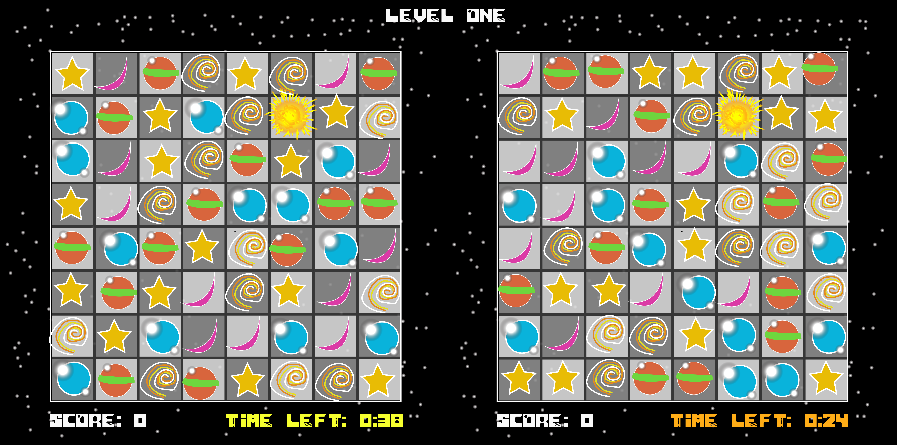
What’s new?

Slide 5
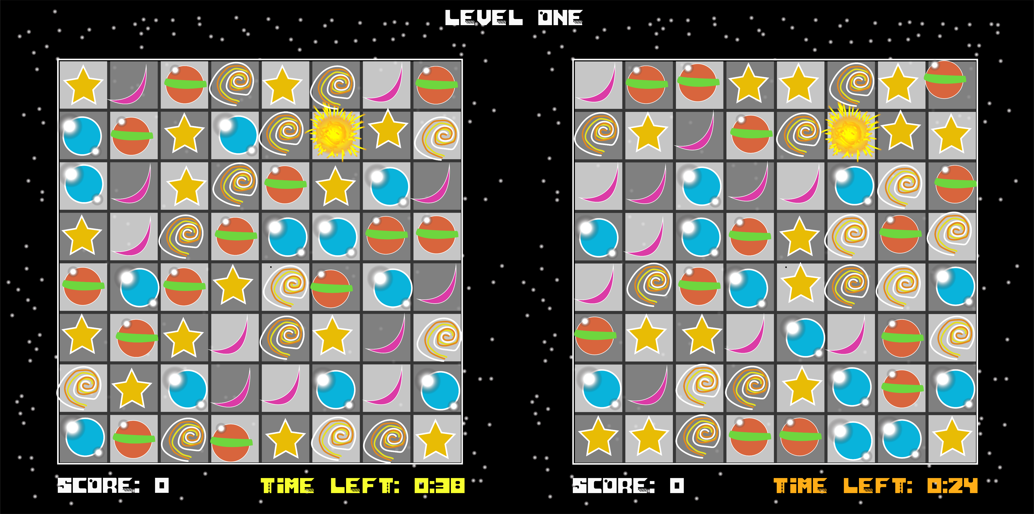
What’s new?
1v1 Multiplayer
Time boxed
Matching increases time remaining
Matches >3 creates special piece, using piece affects other player
Time remaining decrements faster over length of game
Competitive Mode
Difficulty Level
Game over condition
Optional bots

